Slide 1
Chapter 26 Concurrency and Thread
Chien-Chung Shen
CIS/UD
cshen@udel.edu

Slide 2
Introduction
Two abstractions
process – virtualize (one) CPU for concurrency
address space – virtualize memory
New abstraction for programs with single point of execution
thread
Multi-threaded program has more than one point of execution - multiple PCs (program counters), from each of which instructions are being fetched and executed
multiple “light-weight” processes sharing the same address space
context switching between threads
save/restore states of threads
Thread Control Block (TCB) [vs. Process Control Block (PCB)]

Slide 3
Stacks
Single-threaded
2-threaded
one stack per thread

Slide 4
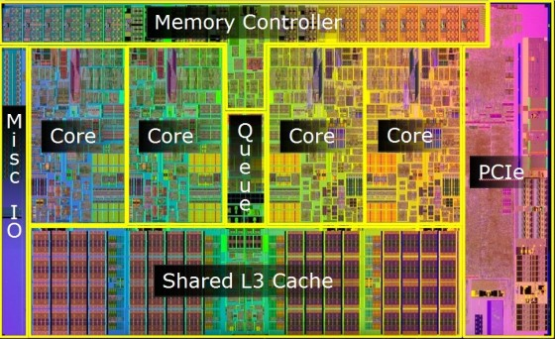
Why Use Threads?
1. Parallelism
parallelization: the task of transforming standard single-threaded program into a program that works on multiple CPUs or cores (one thread per CPU/core)
Intel Core i7
(4 cores)

Slide 5





Why Use Threads?
2. Avoid blocking program progress due to slow I/O
threading enables overlap of I/O with other activities within a single program, much like multiprogramming did for processes across programs
modern server-based applications (web servers, database management systems, etc.) make use of threads
Easy to share data among threads than processes
Web server

Slide 6
Thread Creation
Two threads each runs function mythread() with different arguments
wait for threads to complete

Slide 7
Thread Execution Traces
Hard to tell what will run when

Slide 9
Why It Gets Worse?
Threads interact, and get worse, when they access shared data
Two threads update a global shared variable (t1.c)
Non-deterministic (indeterminate) results due to uncontrolled scheduling
counter = counter + 1;
mov 0x8049a1c, %eax
add $0x1, %eax
mov %eax, 0x8049a1c
Assume variable counter is located at address 0x8049a1c

Slide 10
Thread Interleaving
%eax=51 (in T1’s TCB)

Slide 11
Race Condition
Definition: Results depend on the timing execution of the code - with some bad luck (i.e., context switches that occur at untimely points in the execution), we get the wrong and different results (results are indeterminate)
Because multiple threads executing this code can result in a race condition, we call this code a critical section
A critical section is a piece of code that accesses a shared variable (or more generally, a shared resource) and must not be concurrently executed by more than one thread
Mutual exclusion - property guarantees that if one thread is executing within the critical section, the others will be prevented from doing so [some efforts have to be done to achieve this property]

Slide 12
Atomicity
All or nothing - similar to transaction in database
One way to solve race condition to have more powerful instructions that, in a single step, did exactly whatever we needed done and thus removed the possibility of an untimely interrupt
atomic instructions facilitated by hardware - when an interrupt occurs, either the instruction has not run at all, or it has run to completion; there is no in-between state
feasibility?
No!. So build synchronization primitives on top of a few useful hardware instructions
File systems use techniques of journaling or copy-on-write to atomically transition on-disk state to deal with system failures

Slide 13
Interaction between Threads
Types of interaction between threads
accessing shared variables and the need to support atomicity for critical sections
one thread must wait for another to complete some action before it continues (causality)
Synchronization primitives for
Atomicity (or mutual exclusion)
sleeping/waking interaction (causality)

Slide 14
Why Study Concurrency in OS?
OS was the first concurrent program, and many techniques were created for use within the OS
Later, with multi-threaded processes, application programmers also had to consider concurrency
Every kernel data structure has to be carefully accessed, with the proper synchronization primitives, to work correctly

Slide 15
Concurrency Terms
A critical section is a piece of code that accesses a shared resource, usually a variable or data structure
A race condition arises if multiple threads of execution enter the critical section at roughly the same time; both attempt to update the shared data structure, leading to a surprising (and perhaps undesirable) outcome
An indeterminate program consists of one or more race conditions; the output of the program varies from run to run, depending on which threads ran when. The outcome is thus not deterministic
To avoid these problems, threads should use some kind of mutual exclusion primitives; doing so guarantees that only a single thread ever enters a critical section, thus avoiding races, and resulting in deterministic program outputs.

